Slide 1
Active Listening
Feel the Power
Communicating with Intentions
Fall 2016 Staff Conference
Oklahoma State University Training Services
Notes:
Introduction Game
Cards with dots – choose one
Write your name
A favorite place, or place you would like to visit, and…
A food you despise
I will give you 2 minutes to find your matching dot and introduce yourself and discuss why your dot partner chose that city/country.
Now I would like for you to introduce your dot partner and tell us about their city/country.
You all did great at listening to your partners because you introduced them so well! We will come back to this activity in a minute…but first, here is where we are headed…

Slide 2
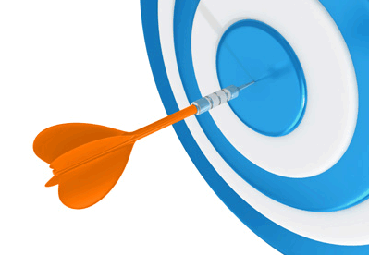
Objectives
Define active listening
Are you an Active listener?
Ways to become a better active listener
Overcoming listening roadblocks
Notes:
11/11/2016
2

Slide 3
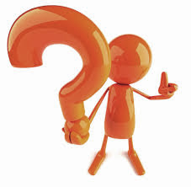
What is your definition of a active listener?
Notes:
In small groups, write a few things down that you think active listeners do while they listen. Think about our first interaction, how did you know the other person was listening to you or that you were being heard?
Those characteristics tie in to the definition of what active listening is…
11/11/2016
3

Slide 4

'Active listening' is a way of listening and responding to another person to improve mutual understanding.
Notes:
Which is a way of listening and responding to another person to improve mutual understanding…there is a lot that goes into it though

Slide 5
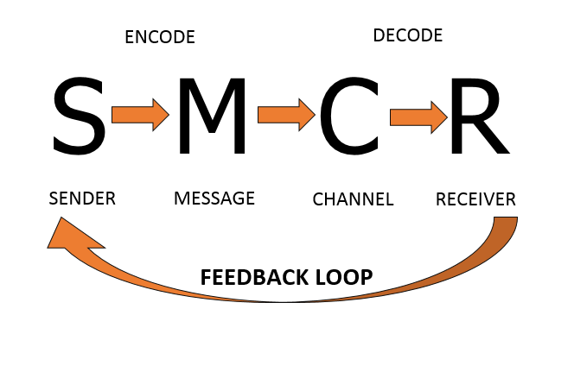
Notes:
Well, what does it look like?
It starts with the sender…deciding what message to send through what channel and the receiver picks it up at that point and has to decode the sender, the message and the channel chosen in order to respond. The receiver is watching and listening – which is what active listening is – so they can respond appropriately.
Here is another way to see Active Listening in action…

Slide 6
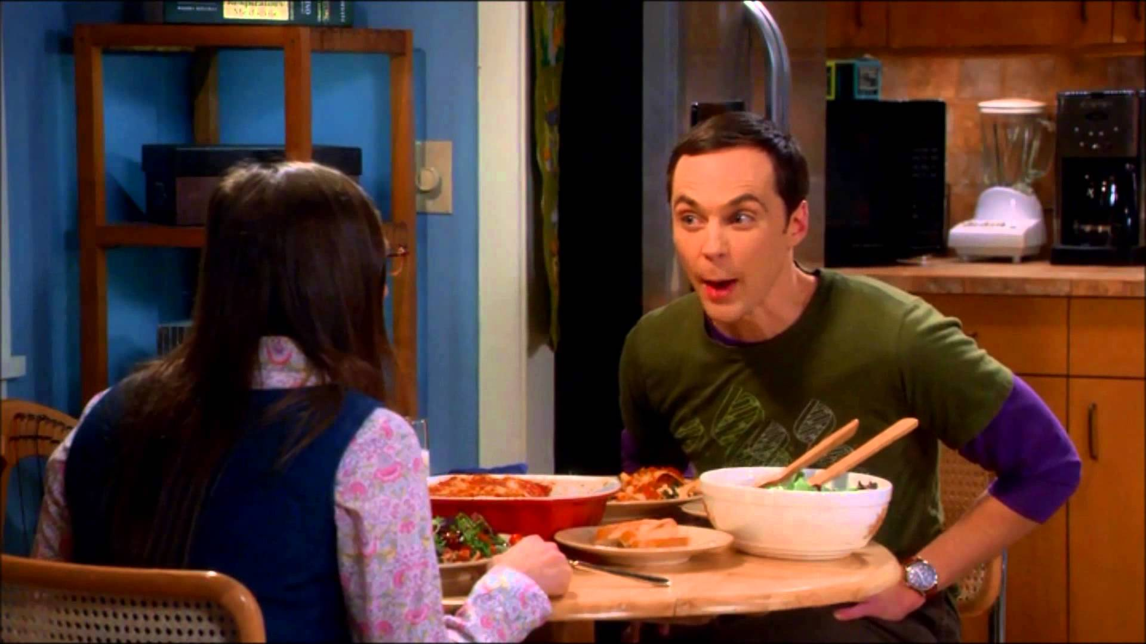
Notes:
Are you an active listener or are you a Sheldon listener?

Slide 7
Notes:
Listening Quiz

Slide 8
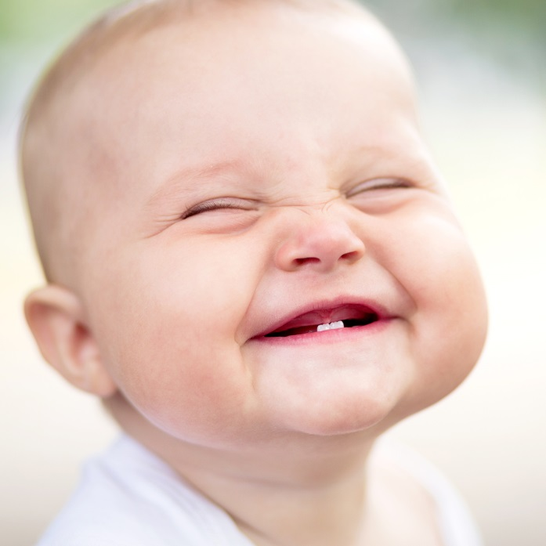
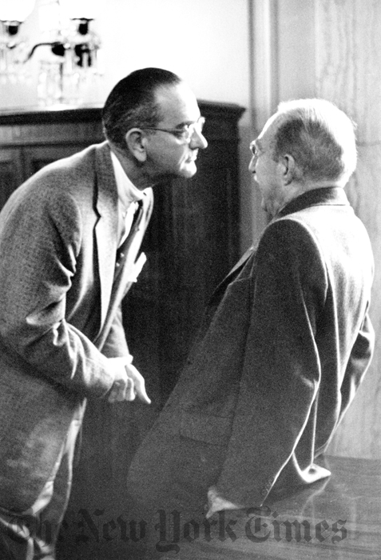
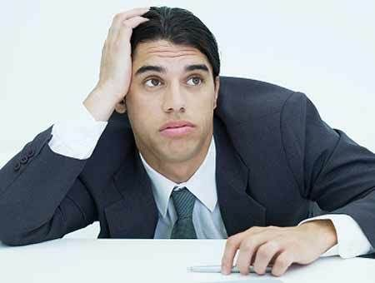
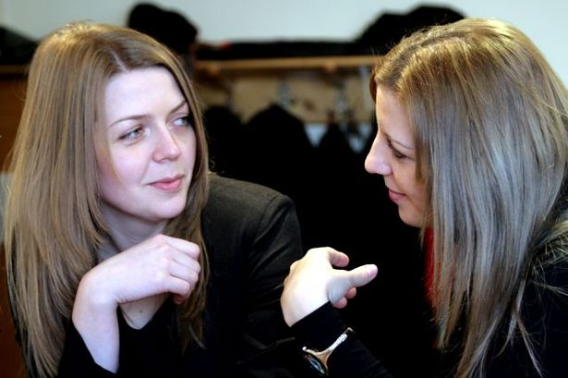
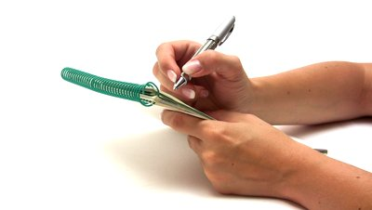
Notes:
Active listening consists of 2 parts – verbal and non-verbal or physical indicators to reinforce listening.

Slide 9
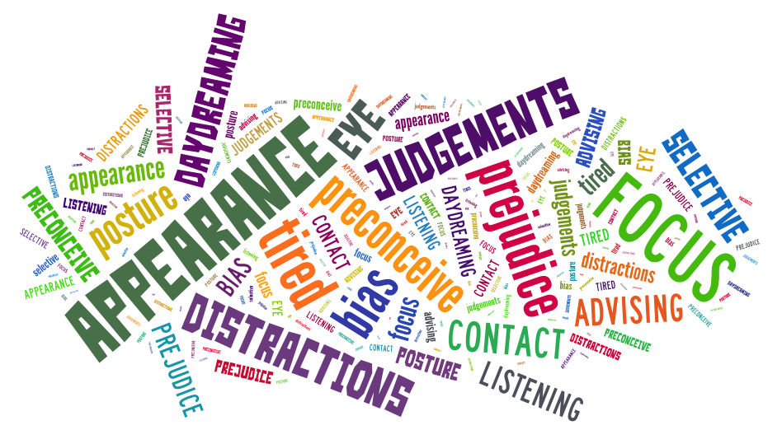
Notes:
On paper, active listening sounds quite simple. However, plenty of things can get tin the way of active listening. Distractions, our mind wondering, the speaker getting off track and even our own judgments can interfere with the message.
QUESTION: What gets in the way of us mastering active listening?
ACTIVITY:
Lets work through some of these scenarios. Groups of 5 or 6, please take a few minutes to come up with some solutions to these common barriers to listening. Your group will need a scribe, and that person is the person who has been at OSU the longest.
I will give you about 10 minutes to come up with your solutions as a group, and the team leader will report back when we come back together as a group.

Slide 10
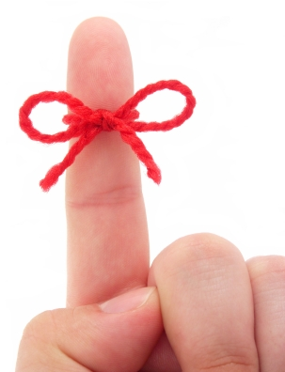
Action
What is one thing
we’ve discussed today that you can start using immediately to improve your communication skills?
Notes:
In your handout, take the time to write down one thing you can start doing differently to help you become a better active listener.
Someone share what they are going to start doing.

Slide 11
“Most people do not listen with the intent to understand; they listen with the intent to reply.”
Stephen Covey
Notes:
I want to leave you with this quote - The key to active listening, listen with the intent to understand.
Thank you for your attention today! Have a great weekend!

